Slide 1
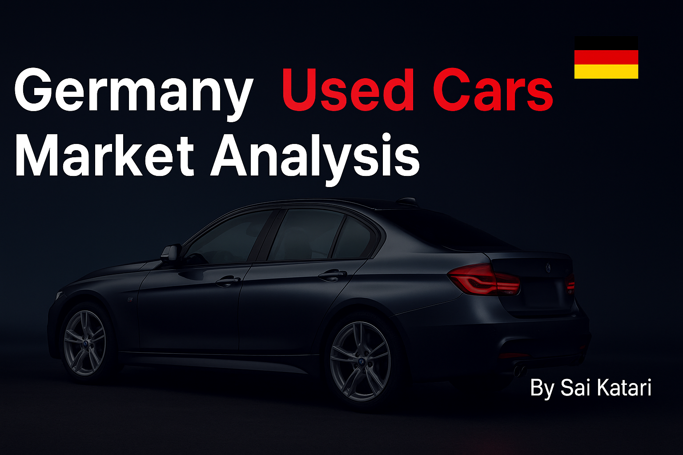
PRESENTATION

Slide 2



Table of contents
Table of contents
Data and project overview
Data cleaning process
PROJECT
Statistical information
Graphical representation of insights
Top collections
Conclusion

Slide 3
Data description
Data description
Source dataset contain data from one of Germany's largest car sales websites, AutoScout24. from 1995 to 2023.
Original dataset consists of 251080 rows and 15 columns
Fields contain information about make, model, price, offer type, mileage, fuel, gear type, horsepower and production year.
.
Data was downloaded from Kaggle.com Collection method – scraping.
Link: https://www.kaggle.com/datasets/wspirat/germany-used-cars-dataset-2023/data

Slide 4





Project objectives
Project objectives
Exploratory Data Analysis (EDA)
Data Analysis
Statistical Analysis
Discovering insights
Graphical representation
Our project begins with handling missing values, removing duplicates, and standardizing inconsistent entries (e.g., fuel types, transmission labels) to ensure reliable analysis.
Using Pandas, NumPy, and Python libraries to explore the dataset, uncover patterns, and evaluate factors affecting used car pricing (brand, year, mileage, fuel type, etc.).
Applying descriptive statistics and correlations to understand the distribution of car features and their impact on pricing. Identifying outliers and trends across time and brands.
Highlighting key findings such as most common brands/models, price variations by fuel type and transmission, and the effect of mileage and year of production on car prices.
Visualizing insights with Matplotlib and Seaborn through bar charts, histograms, scatterplots, and heatmaps to make patterns more interpretable.

Slide 5
Data cleaning
Data cleaning
Different Pandas functions were used to clean and prepare the data for analysis. Process followed the scheme:
Standardizing formats (dates, numbers, categories)
Correcting erroneous values & outliers
Checking duplicates & inconsistencies
Handling missing values
Verification of cleaned dataset
Final cleaned dataset, Germany_used_cars_clean.csv, and notebook file. saved to (GitHub).
Resources

Slide 6
Dataset stats
Dataset stats
Correlation coefficients
Descriptive statistics
 | mileage | price | hp | year
mileage | 1.00 | -0.43 | -0.02 | -0.68
price | -0.43 | 1.00 | 0.70 | 0.41
hp | -0.02 | 0.70 | 1.00 | 0.17
year | -0.68 | 0.41 | 0.17 | 1.00
 | mileage | price | hp
count | 228305.00 | 228305.00 | 228305.00
mean | 87446.64 | 23725.83 | 169.03
std | 76283.76 | 21173.48 | 93.23
min | 0.00 | 500.00 | 34.00
25% | 26150.00 | 11399.00 | 110.00
50% | 70000.00 | 18990.00 | 150.00
75% | 130675.00 | 28980.75 | 190.00
max | 499990.00 | 199999.00 | 956.00
Price shows a strong positive correlation with Horsepower (r=0.70).
Mileage is negatively related to both price (r=-0.43) and year (r=-0.68).
The dataset contains cars priced up to €199,999, mileage up to 499,990 km, and horsepower up to 956 HP.

Slide 7
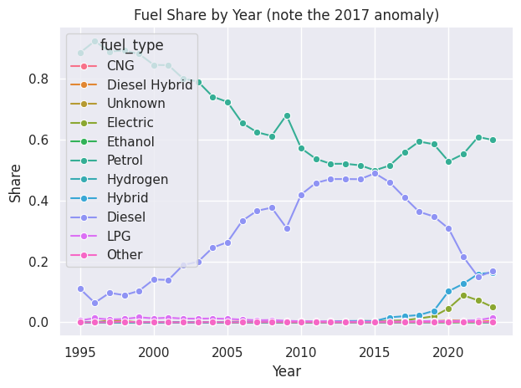
Fuel types
Fuel types
Most of the cars – 57.9 % use Petrol fuel type
Diesel – 33.6 %, Hybrid – 5.1 %, Electric – 2.3 % of all listings
LPG, CNG, Diesel Hybrid, Hydrogen, Other & Unknown vehicles are the least represented – <1 % each

Slide 8
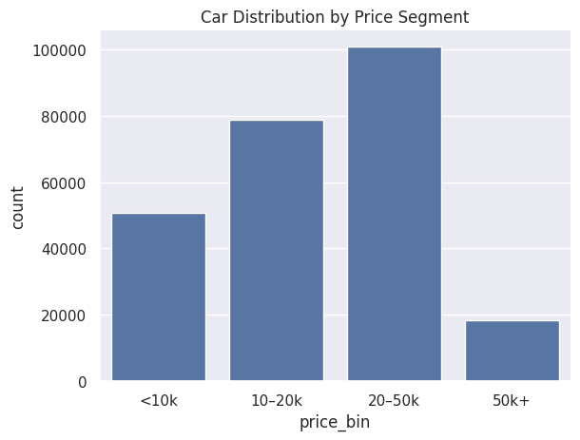
Price categories
Price categories
The most of cars – 49,972 are cheaper than 10,000 €
54.0%, or 123,387 offers, have price less than 20,000 €, and 92.9% or 212,064 are priced under 50,000 €
16,222 vehicles cost more than 50,000 €, with the most expensive costing 199,999 €
The cheapest car is priced at 500 €

Slide 9
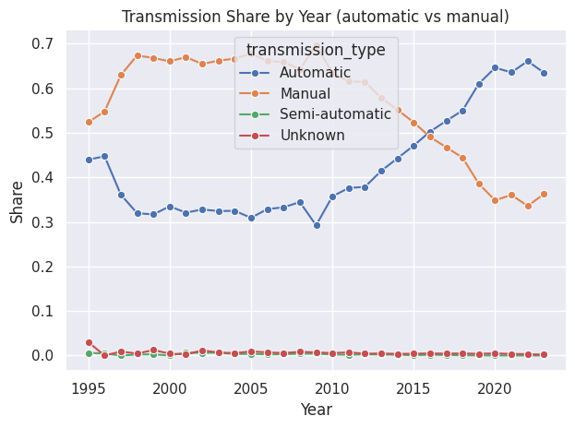
Transmission
Transmission
Most of the offers have an Automatic transmission – almost 116,661 cars (≈51%).
110,314 cars are with a Manual transmission (≈48%).
Only 292 offers have a Semi-automatic gearbox (≈0.1%), while 1,038 offers are listed as Unknown.

Slide 10
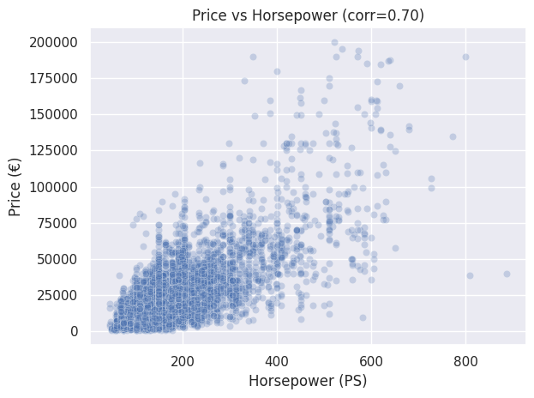
Horsepower
Price vs Horsepower
The lowest horsepower in the dataset is 34 HP. Hyundai IONIQ and Volkswagen Käfer are examples of cars with this power level.
The highest horsepower is 956 HP. Mercedes-Benz E 63 AMG is the car with this maximum horsepower.
Almost 77.9% of all offers have less than 200 HP.

Slide 11
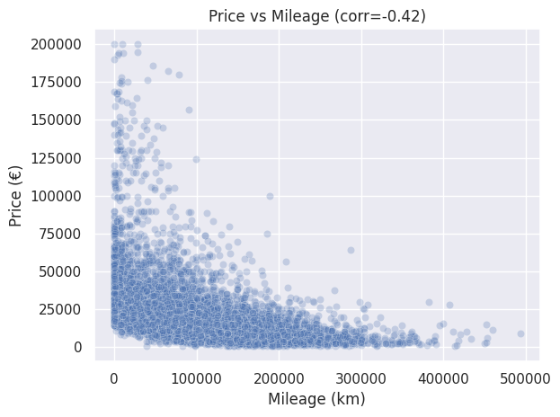
Fuel types by year
Price vs Mileage
Most of the cars with mileage below 70,000 km (median) tend to have higher prices.
Price shows a moderate negative correlation with mileage (−0.42), meaning higher mileage cars are generally cheaper.
25% of cars have mileage below 26,150 km, while 75% are below 130,675 km.
The dataset covers cars with mileage up to 499,990 km and prices up to 199,999 €.

Slide 12
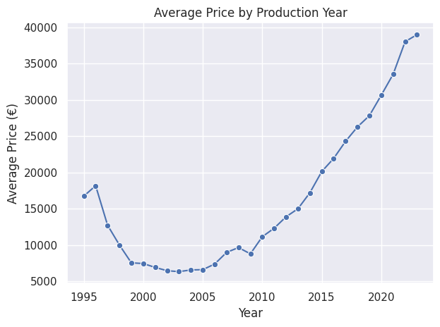
Gear trends
Price Trend
Vehicles from 1995–2005 have the lowest average price (6,000–8,000 €).
From 2010 onwards, the average price rises steadily, surpassing 25,000 € by 2017.
The highest average price (~39,000 €) is observed for 2022–2023 cars, reflecting the premium cost of newer vehicles.

Slide 13
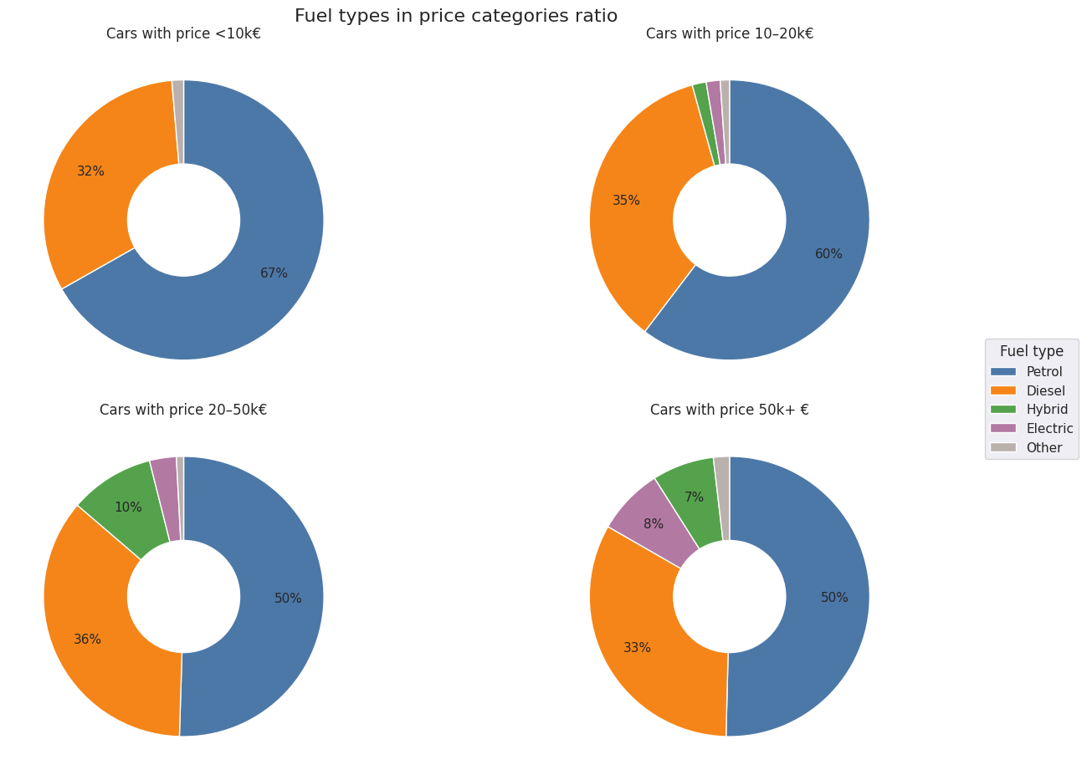
Real price categories
by fuel types
Fuel types in price
categories ratio
Petrol cars dominate all price ranges but drop from 67% (<10k€) to 50% (50k+€).
Hybrid & Electric cars’ share grows with higher prices (Hybrid from 0.4% to 7%, Electric from 1% to 8%).
Diesel share increases with price until mid-range (36% at 20–50k€) but slightly drops in 50k+€.

Slide 14
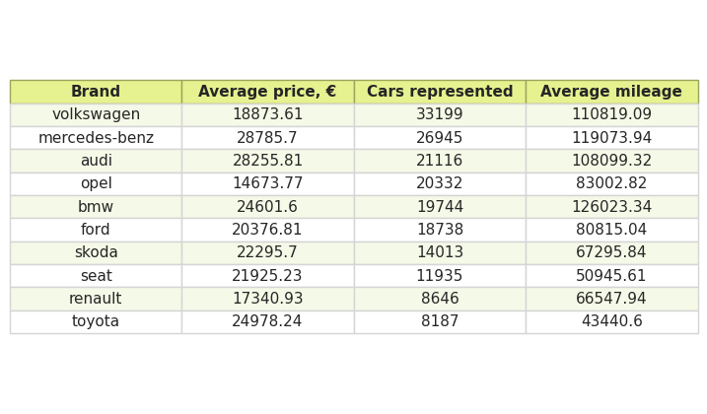










Top 10 popular brands
Top 10 popular brands

Slide 15
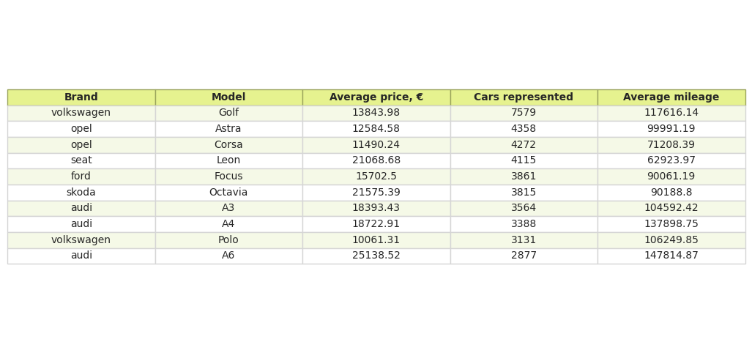
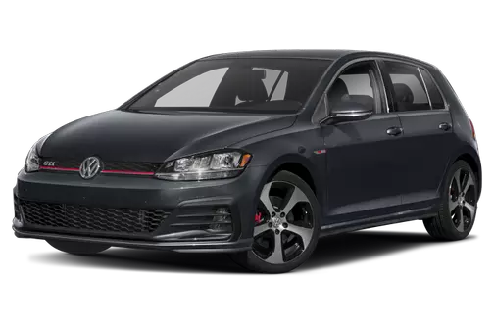
Top 10 popular models
Top 10 popular models

Slide 16
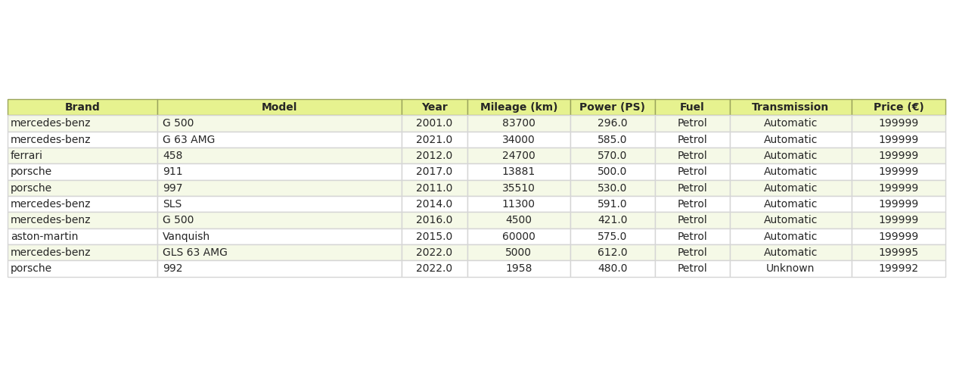
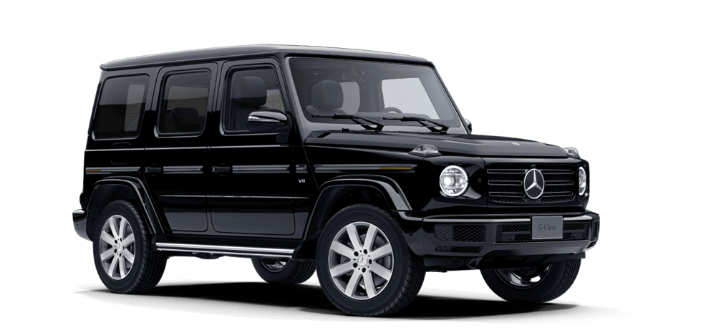
Top 10 expensive cars
Top 10 expensive cars

Slide 17
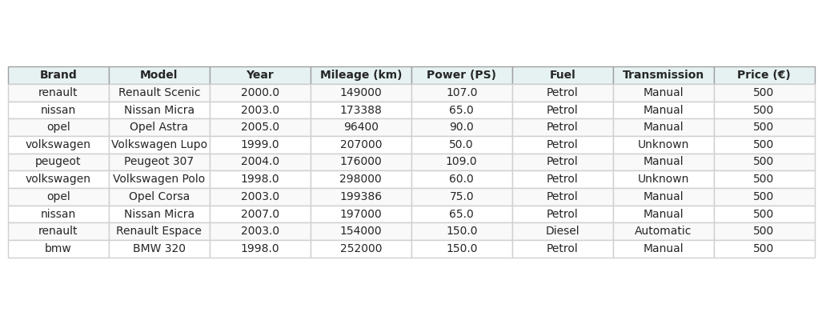
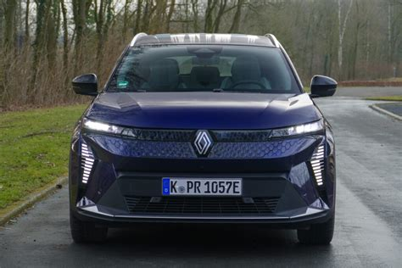
Top 10 cheapest cars
Top 10 cheapest cars

Slide 18
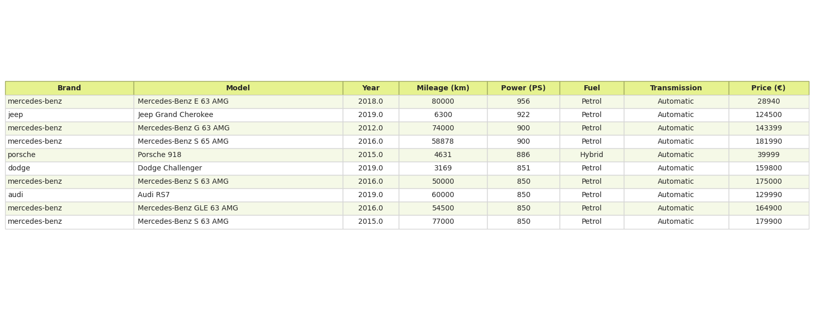
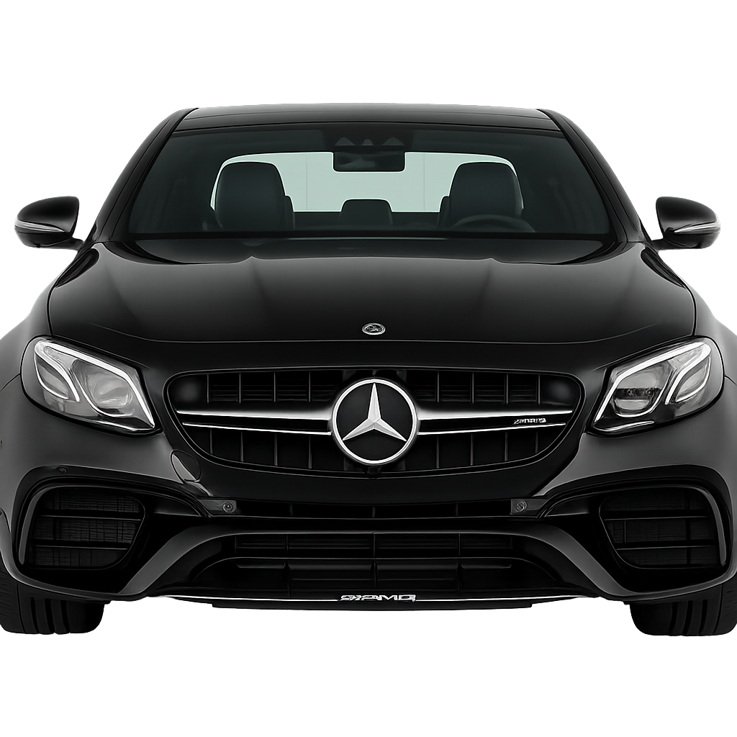
Top 10 powerful
Top 10 powerful cars

Slide 19
Conclusion
Conclusion
In this project, we analyzed data on Used German cars sourced from Kaggle(AutoScout24). Using Python (Google Colab), I cleaned, transformed, and visualized the dataset to extract actionable insights. Relationships and trends between price, mileage, horsepower, fuel type, transmission, and production year were identified.
Key Findings & Insights:
A notable anomaly in 2017: diesel vehicles peaked at 43% while petrol dipped.
Horsepower positively correlates with price (r ≈ 0.70).
Mileage negatively correlates with price (r ≈ -0.43).
A shift from manual to automatic transmissions after 2018.
Hybrid and electric vehicles show gradual market growth in higher price segments.
Technologies & Libraries: Python (Google Colab), Pandas, Seaborn, Scikit-learn, Matplotlib.
Portfolio: Github

Slide 20


